Slide 1
Tracking
Slides copied from Juan Carlos Niebles and Ranjay Krishna, Stanford Vision and Learning Lab

Slide 2
What we will learn today?
Feature Tracking
Simple KLT tracker
2D transformations
Iterative KLT tracker
Reading: [Szeliski] Chapters: 8.4, 8.5
[Fleet & Weiss, 2005]
http://www.cs.toronto.edu/pub/jepson/teaching/vision/2503/opticalFlow.pdf

Slide 3
What we will learn today?
Feature Tracking
Simple KLT tracker
2D transformations
Iterative KLT tracker
Reading: [Szeliski] Chapters: 8.4, 8.5
[Fleet & Weiss, 2005]
http://www.cs.toronto.edu/pub/jepson/teaching/vision/2503/opticalFlow.pdf

Slide 4
Motion estimation techniques
Optical flow
Recover image motion at each pixel from spatio-temporal image brightness variations (optical flow)
Feature-tracking
Extract visual features (corners, textured areas) and “track” them over multiple frames

Slide 5
Optical flow can help track features
Once we have the features we want to track, lucas-kanade or other optical flow algorithsm can help track those features

Slide 6
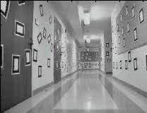
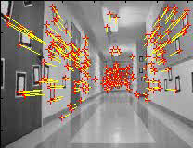
Feature-tracking
Courtesy of Jean-Yves Bouguet – Vision Lab, California Institute of Technology

Slide 7
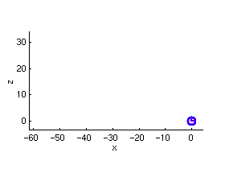
Feature-tracking
Courtesy of Jean-Yves Bouguet – Vision Lab, California Institute of Technology

Slide 8
What we will learn today?
Feature Tracking
Simple KLT tracker
2D transformations
Iterative KLT tracker
Reading: [Szeliski] Chapters: 8.4, 8.5
[Fleet & Weiss, 2005]
http://www.cs.toronto.edu/pub/jepson/teaching/vision/2503/opticalFlow.pdf

Slide 9
Simple KLT tracker
Find a good point to track (harris corner)
For each Harris corner compute motion (translation or affine) between consecutive frames.
Link motion vectors in successive frames to get a track for each Harris point
Introduce new Harris points by applying Harris detector at every m (10 or 15) frames
Track new and old Harris points using steps 1‐3

Slide 10
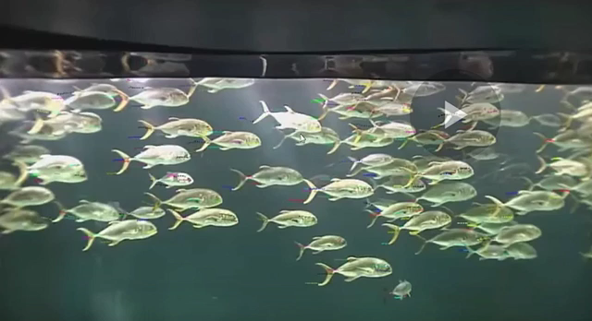
KLT tracker for fish
Video credit: Kanade

Slide 11
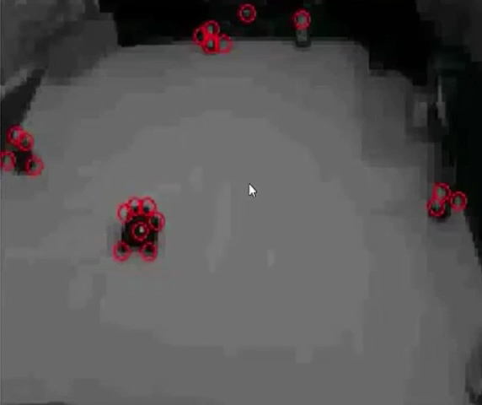
Tracking cars
Video credit: Kanade

Slide 12
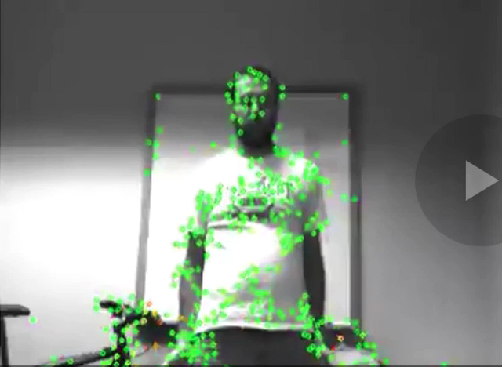
Tracking movement
Video credit: Kanade

Slide 13
What we will learn today?
Feature Tracking
Simple KLT tracker
2D transformations
Iterative KLT tracker
Reading: [Szeliski] Chapters: 8.4, 8.5
[Fleet & Weiss, 2005]
http://www.cs.toronto.edu/pub/jepson/teaching/vision/2503/opticalFlow.pdf

Slide 14
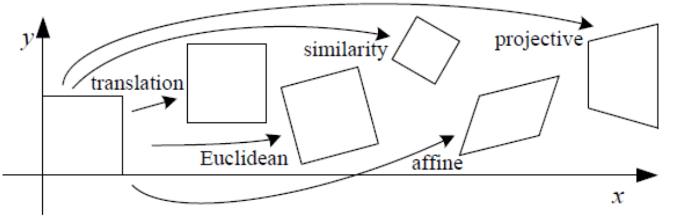
Types of 2D transformations

Slide 15
Translation
Let the initial feature be located by (x, y).
In the next frame, it has translated to (x’, y’).
We can write the transformation as: x’ = x + b₁ y’ = y + b₂
(x’,y’)
(x,y)

Slide 16
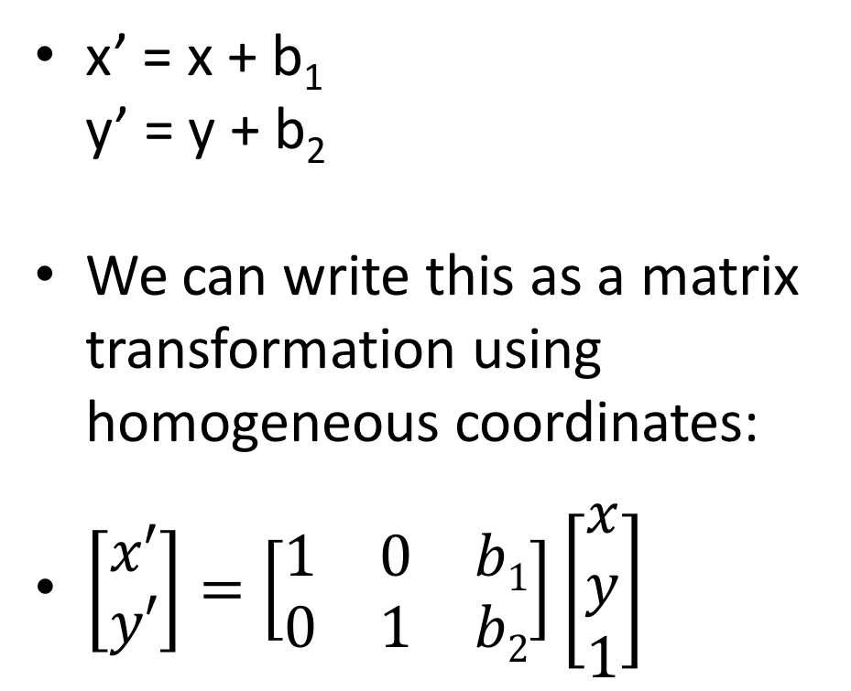
Translation
x’ = x + b₁ y’ = y + b₂
We can write this as a matrix transformation using homogeneous coordinates:
$\left[\begin{matrix}x′ \\ y′\end{matrix}\right]=\left[\begin{matrix}1 & 0 & b1 \\ 0 & 1 & b2\end{matrix}\right]\left[\begin{aligned}x \\ y \\ 1\end{aligned}\right]$
(x’,y’)
(x,y)

Slide 17
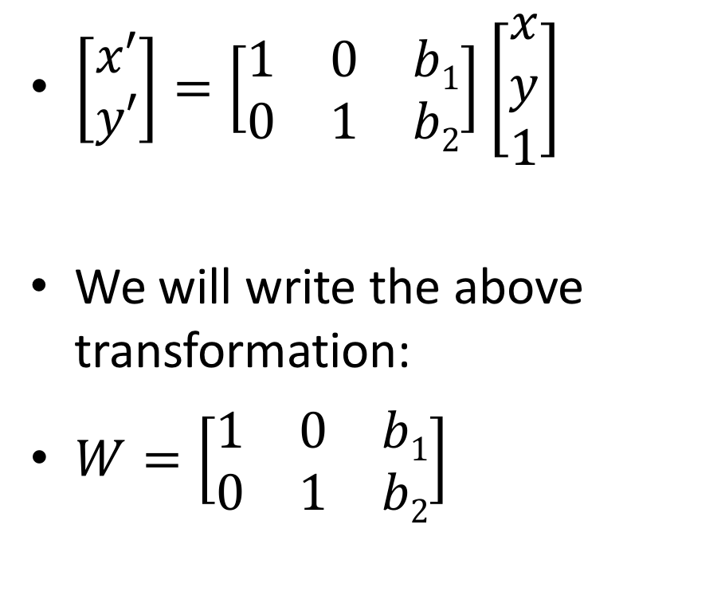
Translation
$\left[\begin{matrix}x′ \\ y′\end{matrix}\right]=\left[\begin{matrix}1 & 0 & b1 \\ 0 & 1 & b2\end{matrix}\right]\left[\begin{aligned}x \\ y \\ 1\end{aligned}\right]$
We will write the above transformation:
$W=\left[\begin{matrix}1 & 0 & b1 \\ 0 & 1 & b2\end{matrix}\right]$
(x’,y’)
(x,y)

Slide 18
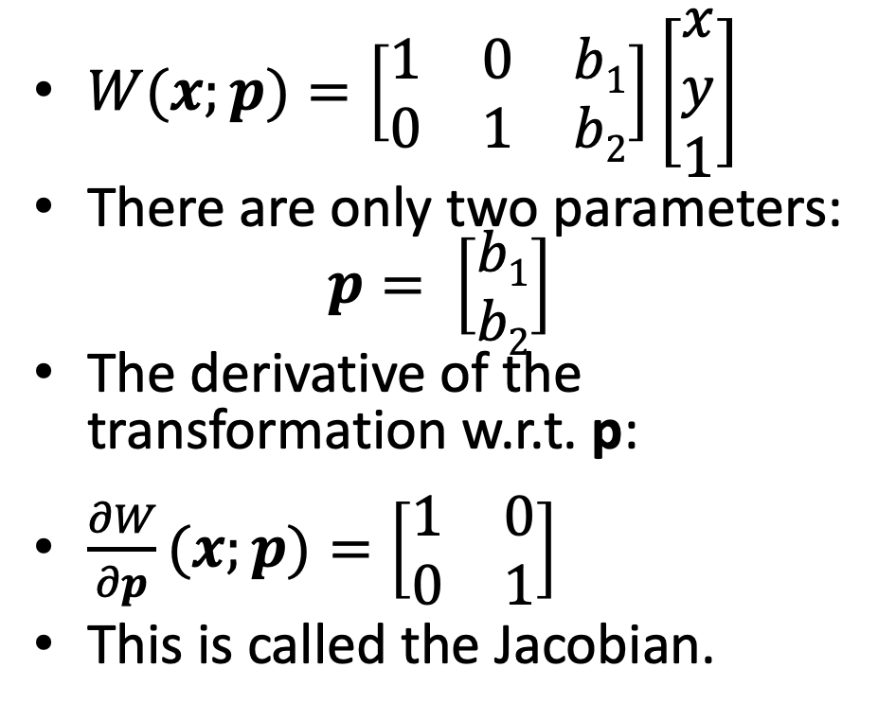
Displacement Model for Translation
$W(x;p)=\left[\begin{matrix}1 & 0 & b1 \\ 0 & 1 & b2\end{matrix}\right]\left[\begin{aligned}x \\ y \\ 1\end{aligned}\right]$
There are only two parameters: $p= \left[\begin{matrix}b1 \\ b2\end{matrix}\right]$
The derivative of the transformation w.r.t. p:
$\frac{∂W}{∂p}(x;p)=\left[\begin{matrix}1 & 0 \\ 0 & 1\end{matrix}\right]$
This is called the Jacobian.
(x’,y’)
(x,y)

Slide 19
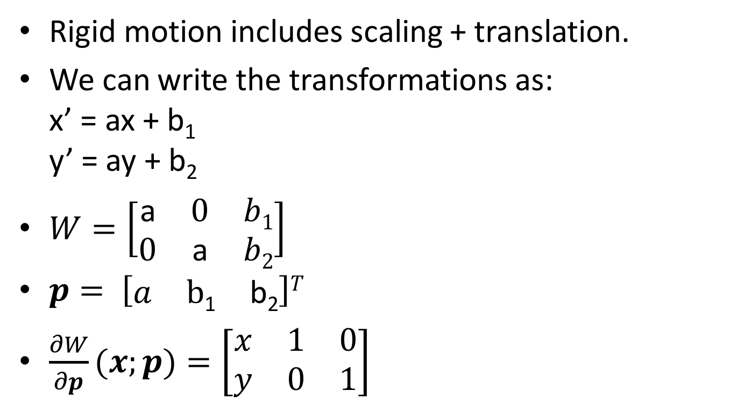
Similarity motion
Rigid motion includes scaling + translation.
We can write the transformations as: x’ = ax + b₁ y’ = ay + b₂
$W=\left[\begin{matrix}\text{a} & 0 & b1 \\ 0 & \text{a} & b2\end{matrix}\right]$
$p= \left[\begin{matrix}a & \text{b}\text{1} & \text{b}\text{2}\end{matrix}\right]T$
$\frac{∂W}{∂p}(x;p)=\left[\begin{matrix}x & 1 & 0 \\ y & 0 & 1\end{matrix}\right]$

Slide 20
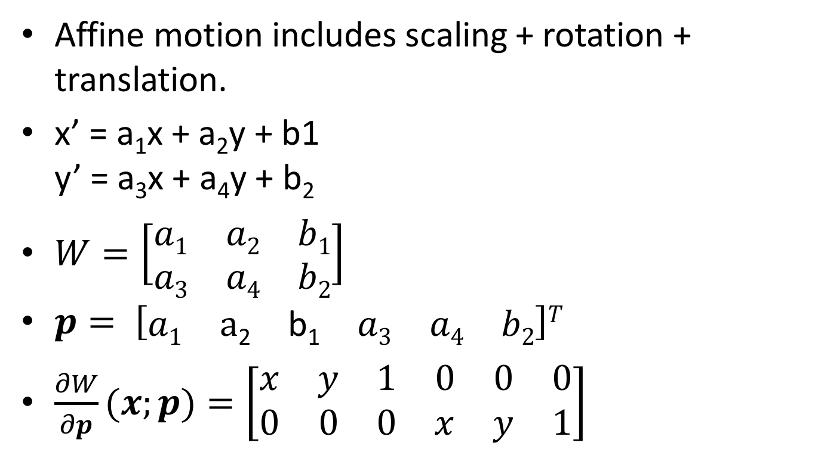
Affine motion
Affine motion includes scaling + rotation + translation.
x’ = a₁x + a₂y + b1 y’ = a₃x + a₄y + b₂
$W=\left[\begin{matrix}a1 & a2 & b1 \\ a3 & a4 & b2\end{matrix}\right]$
$p= \left[\begin{matrix}a1 & \text{a}\text{2} & \text{b}\text{1} & a3 & a4 & b2\end{matrix}\right]T$
$\frac{∂W}{∂p}(x;p)=\left[\begin{matrix}x & y & 1 & 0 & 0 & 0 \\ 0 & 0 & 0 & x & y & 1\end{matrix}\right]$

Slide 21
What we will learn today?
Feature Tracking
Simple KLT tracker
2D transformations
Iterative KLT tracker
Reading: [Szeliski] Chapters: 8.4, 8.5
[Fleet & Weiss, 2005]
http://www.cs.toronto.edu/pub/jepson/teaching/vision/2503/opticalFlow.pdf

Slide 22
Problem formulation
Given a video sequence, find all the features and track them across the video.
First, use Harris corner detection to find the features.
For each feature at location x = [x y]^{T}:
Choose a descriptor create an initial template for that feature: T(x).

Slide 23
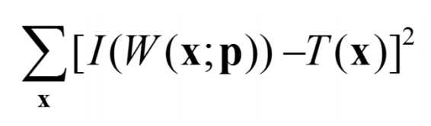
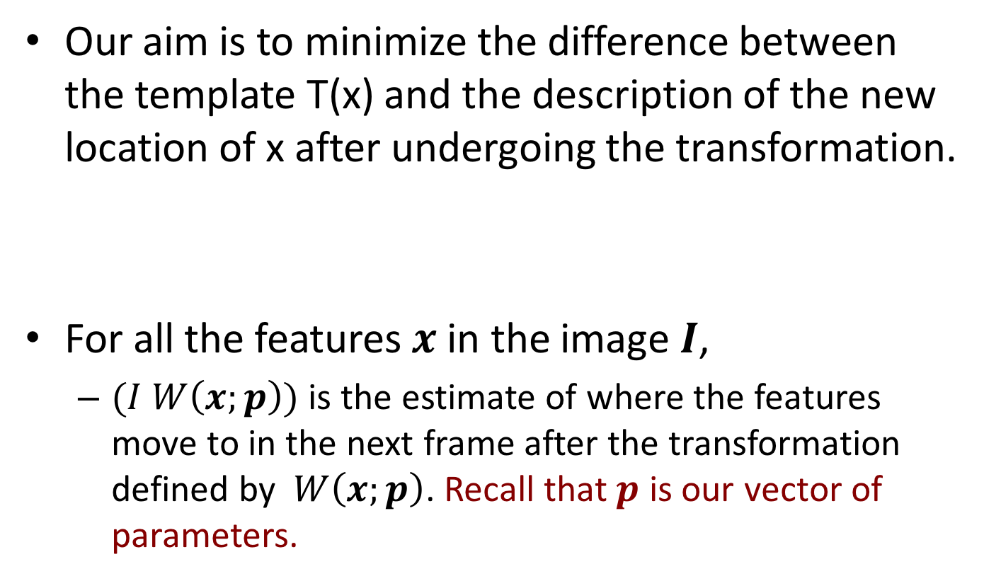
KLT objective
Our aim is to minimize the difference between the template T(x) and the description of the new location of x after undergoing the transformation.
For all the features $x$ in the image $I$,
$(I W\left(x;p\right))$ is the estimate of where the features move to in the next frame after the transformation defined by $W\left(x;p\right)$. Recall that $p$ is our vector of parameters.

Slide 24
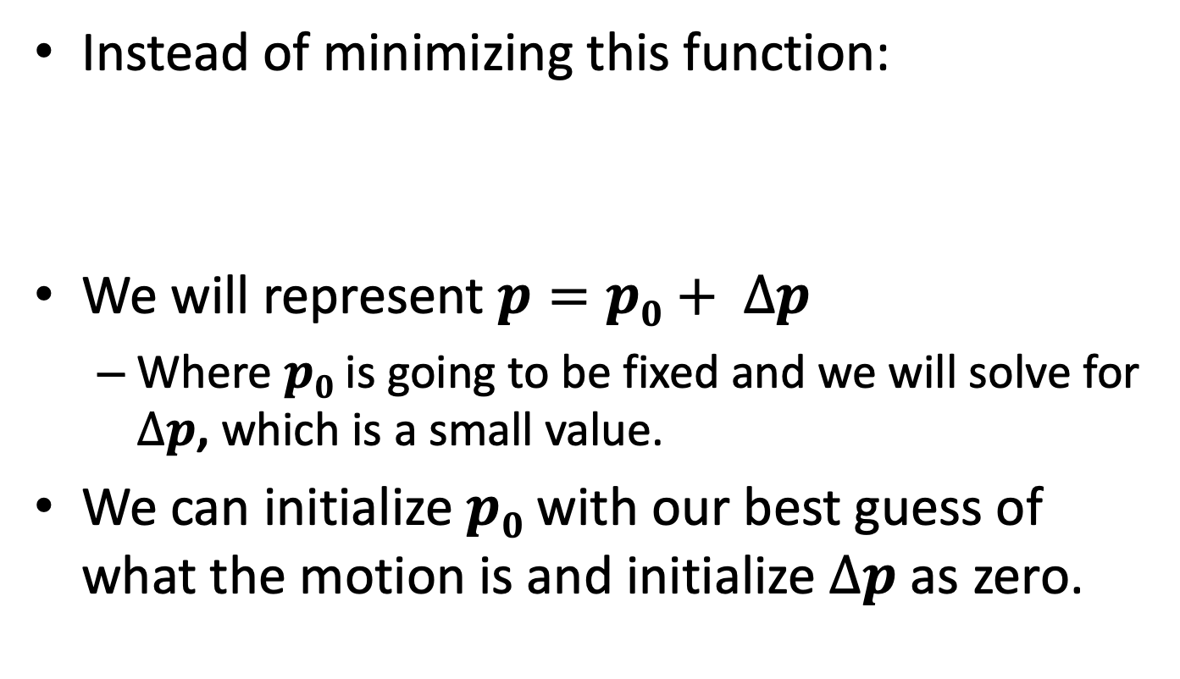
KLT objective
Instead of minimizing this function:
We will represent $p=p0+ ∆p$
Where $p0$ is going to be fixed and we will solve for $∆p$, which is a small value.
We can initialize $p0$ with our best guess of what the motion is and initialize $∆p$ as zero.

Slide 25
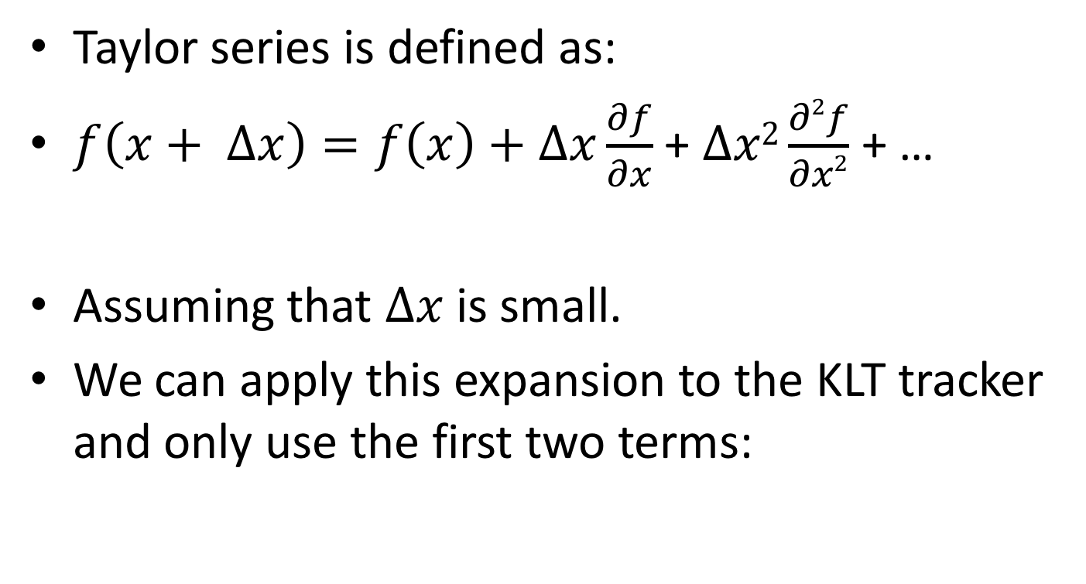
A little bit of math: Taylor series
Taylor series is defined as:
$f\left(x+ ∆x\right)=f\left(x\right)+∆x\frac{∂f}{∂x}$ + $∆x2\frac{∂2f}{∂x2}$ + …
Assuming that $∆x$ is small.
We can apply this expansion to the KLT tracker and only use the first two terms:

Slide 26
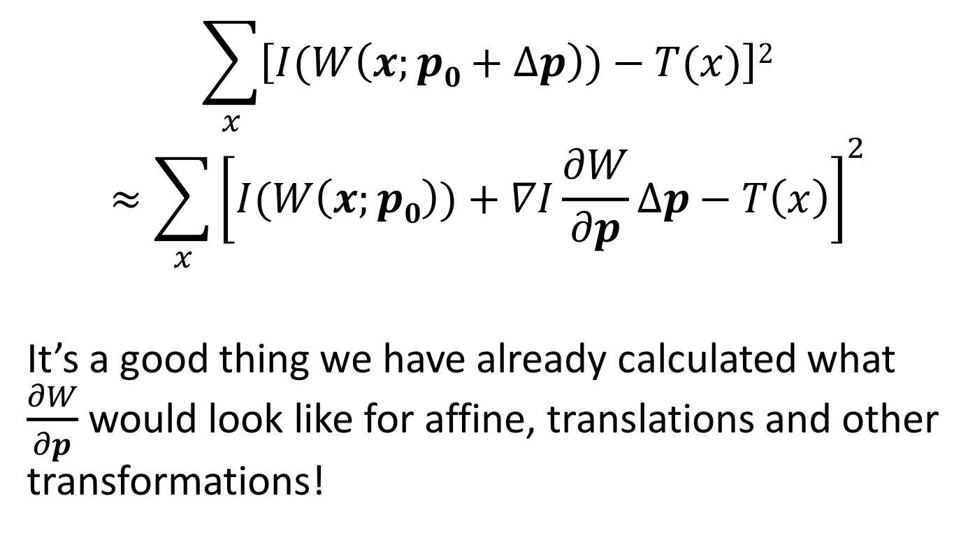
Expanded KLT objective
$$\sum_{x}{\left[I(W\left(x;p0+∆p\right))−T(x)\right]2}$$
$$≈\sum_{x}{{\left[I(W\left(x;p0\right))+∇I\frac{∂W}{∂p}∆p−T\left(x\right)\right]}^{2}}$$
It’s a good thing we have already calculated what $\frac{∂W}{∂p}$ would look like for affine, translations and other transformations!

Slide 27
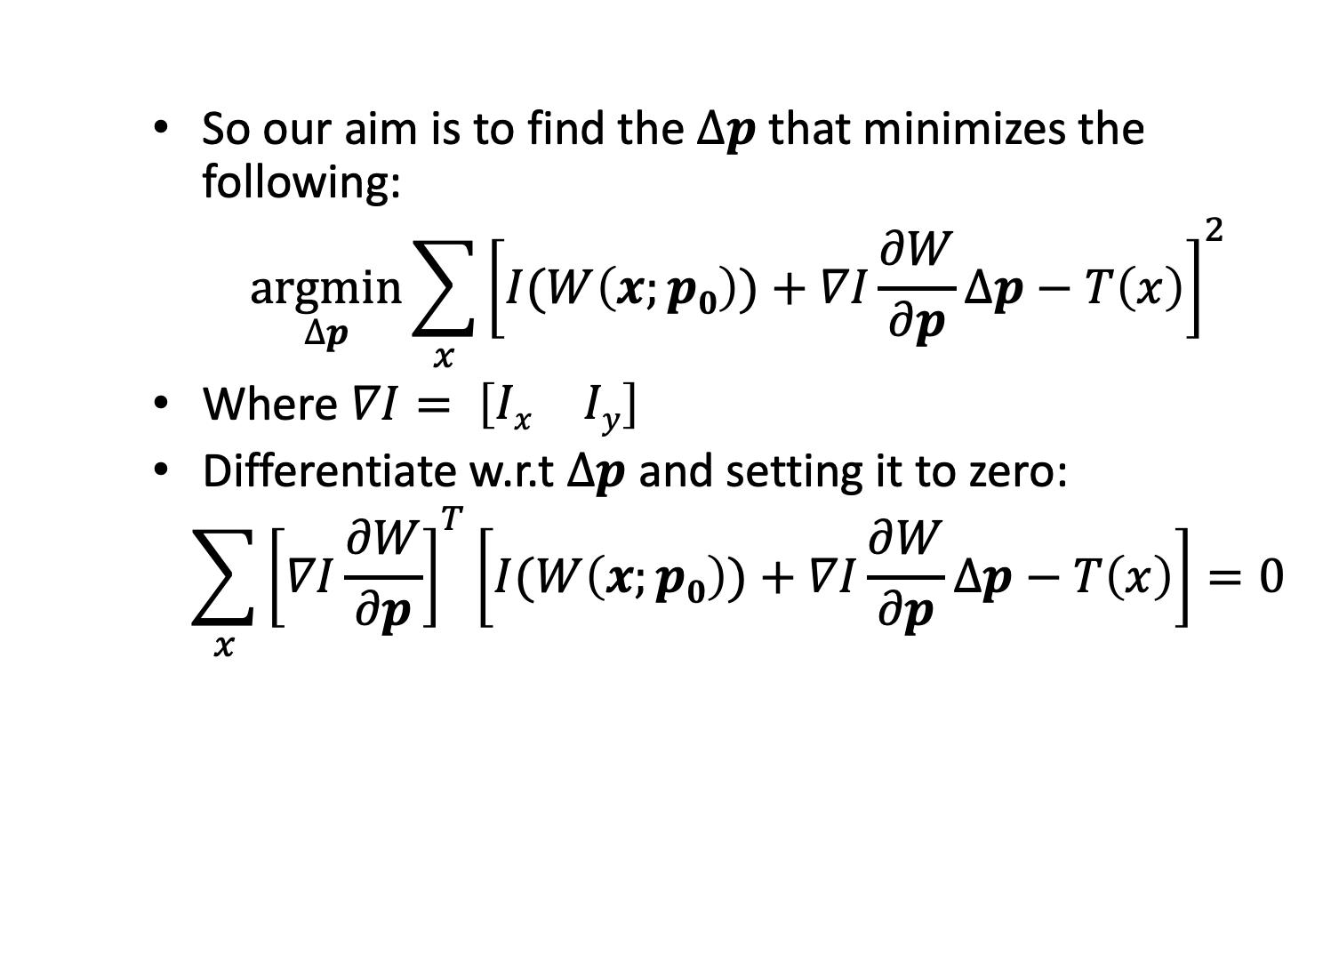
Expanded KLT objective
So our aim is to find the $∆p$ that minimizes the following:
$$\underset{∆p}{argmin}{\sum_{x}{{\left[I(W\left(x;p0\right))+∇I\frac{∂W}{∂p}∆p−T\left(x\right)\right]}^{2}}}$$
Where $∇I= \left[\begin{matrix}Ix & Iy\end{matrix}\right]$
Differentiate w.r.t $∆p$ and setting it to zero:
$$\sum_{x}{{\left[∇I\frac{∂W}{∂p}\right]}^{T}\left[I(W\left(x;p0\right))+∇I\frac{∂W}{∂p}∆p−T\left(x\right)\right]=0}$$

Slide 28
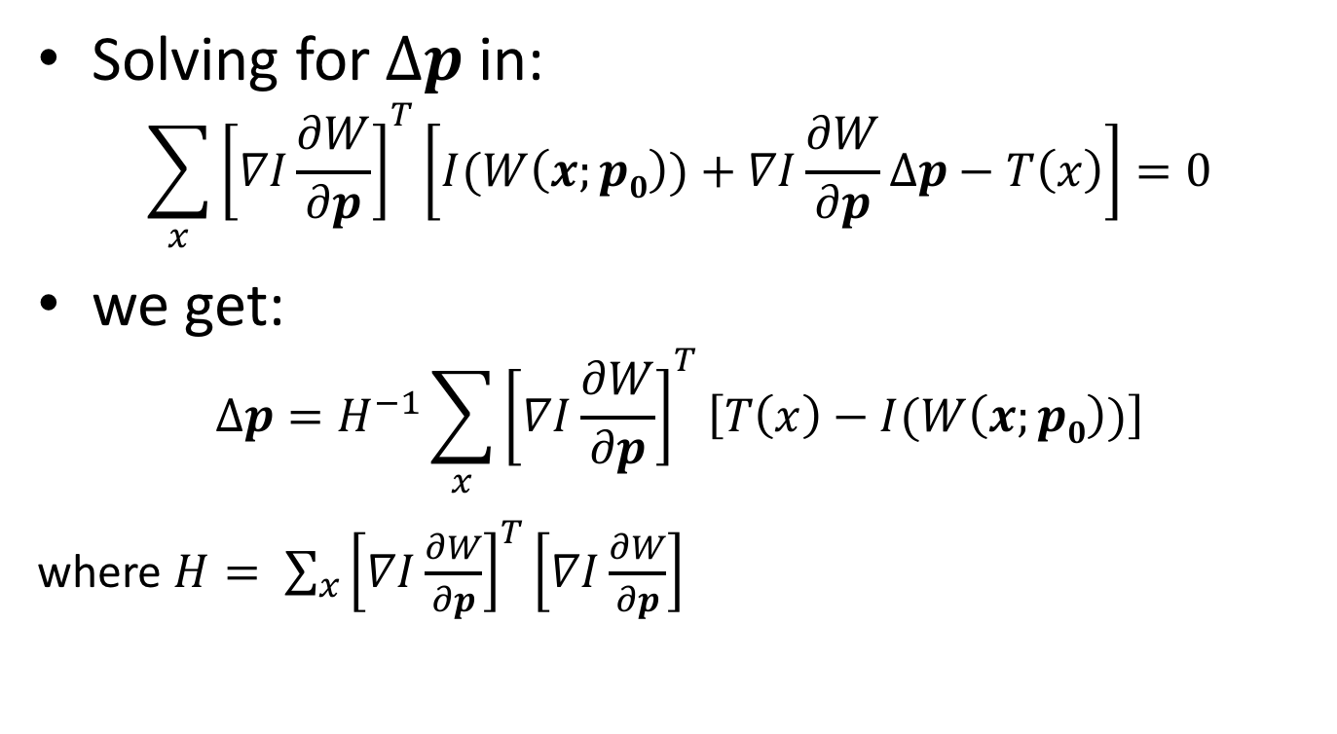

Solving for $∆p$
Solving for $∆p$ in:
$$\sum_{x}{{\left[∇I\frac{∂W}{∂p}\right]}^{T}\left[I(W\left(x;p0\right))+∇I\frac{∂W}{∂p}∆p−T\left(x\right)\right]=0}$$
we get:
$$∆p=H^{−1}\sum_{x}{{\left[∇I\frac{∂W}{∂p}\right]}^{T}\left[T\left(x\right)−I(W\left(x;p0\right))\right]}$$
where $H= \sum_{x}{{\left[∇I\frac{∂W}{∂p}\right]}^{T}\left[∇I\frac{∂W}{∂p}\right]}$

Slide 29
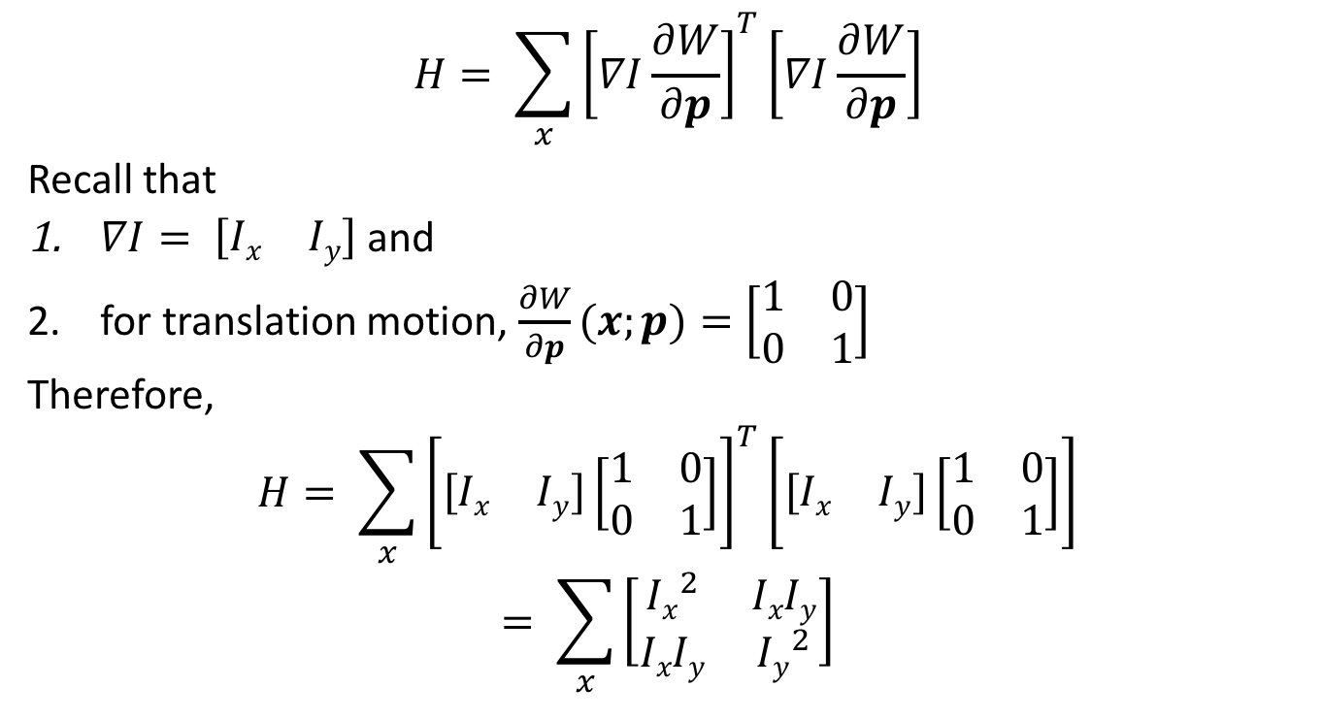
Interpreting the H matrix for translation transformations
$$H= \sum_{x}{{\left[∇I\frac{∂W}{∂p}\right]}^{T}\left[∇I\frac{∂W}{∂p}\right]}$$
Recall that
$∇I= \left[\begin{matrix}Ix & Iy\end{matrix}\right]$ and
for translation motion, $\frac{∂W}{∂p}(x;p)=\left[\begin{matrix}1 & 0 \\ 0 & 1\end{matrix}\right]$
Therefore,
$$H= \sum_{x}{{\left[\left[\begin{matrix}Ix & Iy\end{matrix}\right]\left[\begin{matrix}1 & 0 \\ 0 & 1\end{matrix}\right]\right]}^{T}\left[\left[\begin{matrix}Ix & Iy\end{matrix}\right]\left[\begin{matrix}1 & 0 \\ 0 & 1\end{matrix}\right]\right]}$$
$$= \sum_{x}{\left[\begin{matrix}{Ix}^{2} & IxIy \\ IxIy & {Iy}^{2}\end{matrix}\right]}$$
That’s the Harris corner detector we learnt in class!!!

Slide 30
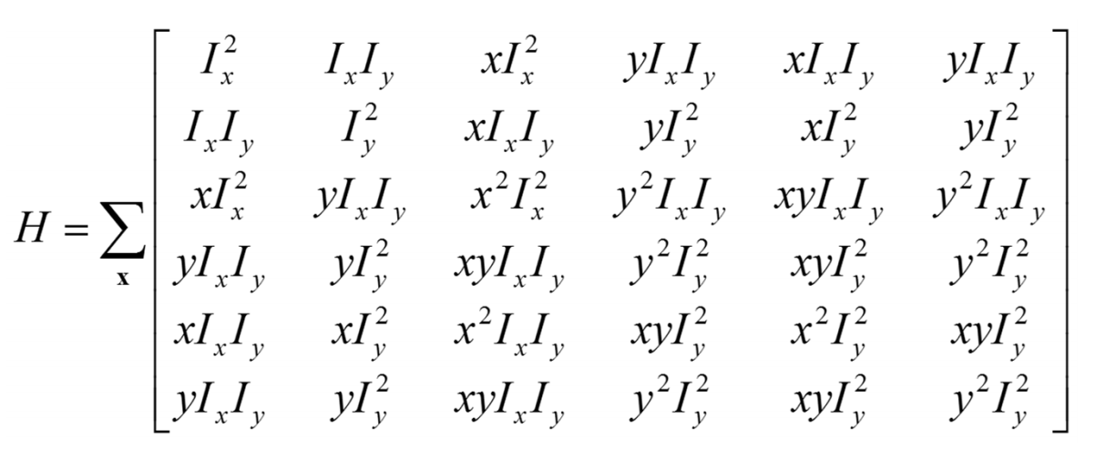
Interpreting the H matrix for affine transformations
Can you derive this yourself similarly to how we derived the translation transformation?

Slide 31
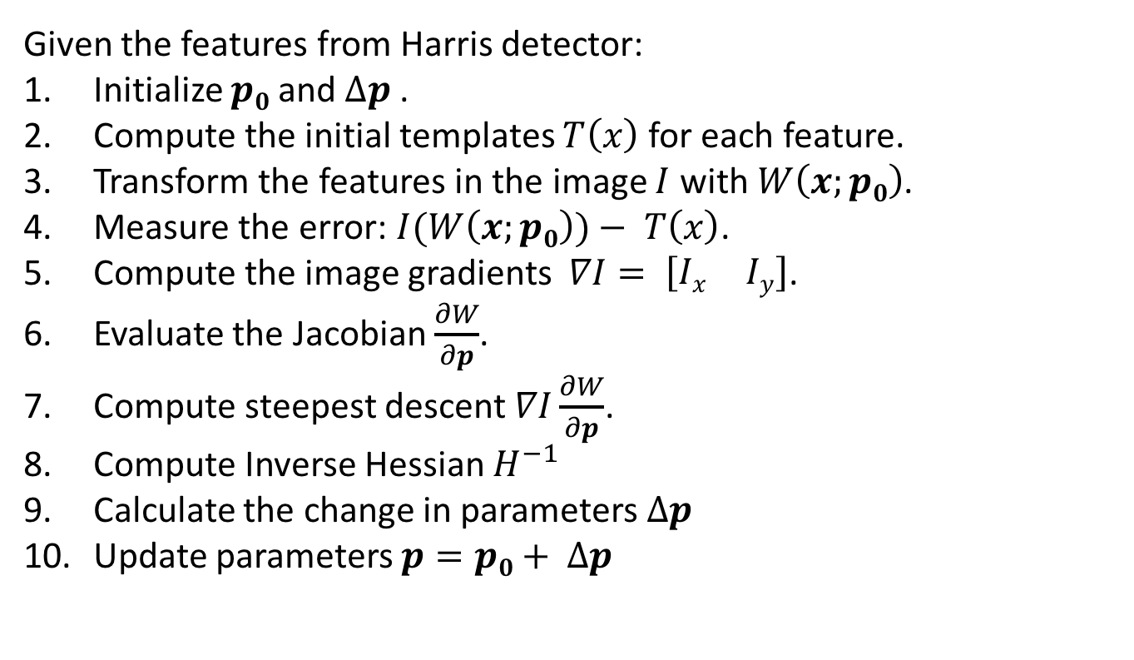
Overall KLT tracker algorithm
Given the features from Harris detector:
Initialize $p0$and $∆p$.
Compute the initial templates $T\left(x\right)$ for each feature.
Transform the features in the image $I$ with $W\left(x;p0\right)$.
Measure the error: $I(W\left(x;p0\right))− T\left(x\right)$.
Compute the image gradients $∇I= \left[\begin{matrix}Ix & Iy\end{matrix}\right]$.
Evaluate the Jacobian $\frac{∂W}{∂p}$.
Compute steepest descent $∇I\frac{∂W}{∂p}$.
Compute Inverse Hessian $H^{−1}$
Calculate the change in parameters $∆p$
Update parameters $p=p0+ ∆p$

Slide 32
Iterative KLT
Once you find a transformation for two frames, you will repeat this process for every couple of frames.
Run Harris detector every 15-20 frames to find new features.

Slide 33
Challenges to consider
Implementation issues
Window size
Small window more sensitive to noise and may miss larger motions (without pyramid)
Large window more likely to cross an occlusion boundary (and it’s slower)
15x15 to 31x31 seems typical
Weighting the window
Common to apply weights so that center matters more (e.g., with Gaussian)

Slide 34
What we learnt today?
Feature Tracking
Simple KLT tracker
2D transformations
Iterative KLT tracker
Reading: [Szeliski] Chapters: 8.4, 8.5
[Fleet & Weiss, 2005]
http://www.cs.toronto.edu/pub/jepson/teaching/vision/2503/opticalFlow.pdf

